Slide 1

Could you pick up milk if you are at Safeway, please?

Slide 2
Trip to the store for just a few items is painful

Slide 3
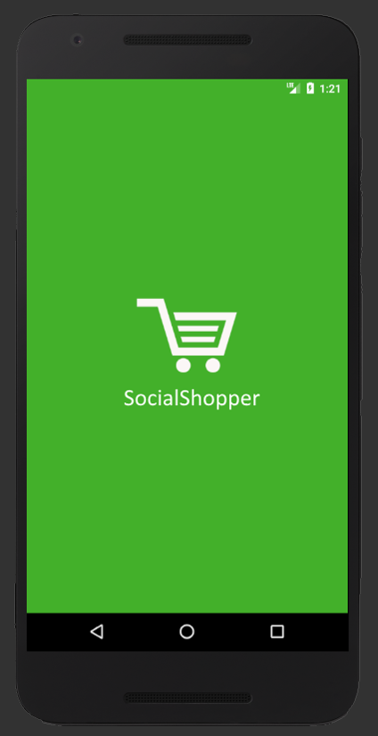

Slide 4
Design Thoughts
Trust
Friends and family handle your food
1
Experience
Fun, Fast, Intuitive
2
Messaging
Reach people when they are most likely to help
3

Slide 5
demo

Slide 6
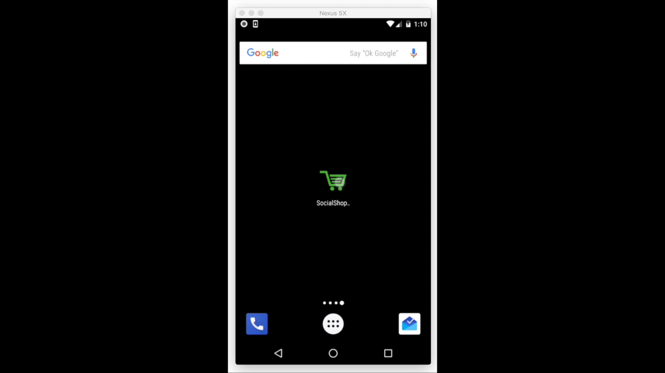

Slide 7
The Future
Larger Community
Not just friends,
But whoever you want
1
More Personalized
Learning your choices
2
Bigger Selection
Always find what you need
3

Slide 8
SocialShopper
Sriram Santosh Aripirala (Intuit)
Greeshma Umapathi (Expedia)
Rahul Deshpande (McAfee)

